Slide 1
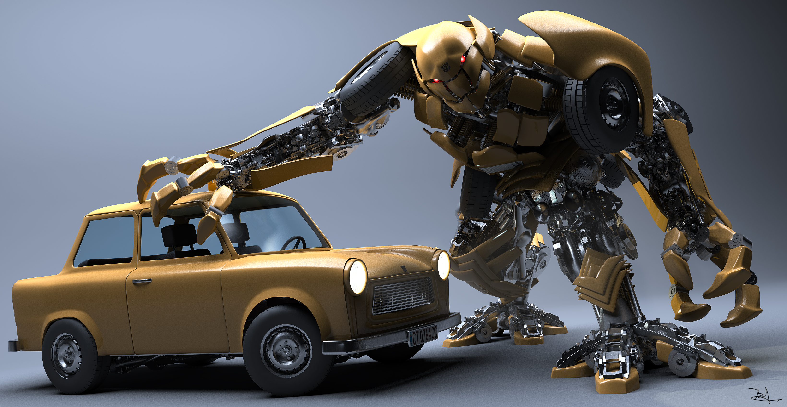
CSC2003 Embedded Systems
Group B1 – Modular Design

Slide 2

Overview of system
5 separate modules will be connected to 1 MSP Board, forming 1 car
Motor Control
Infrared (Encoder + Barcode)
Ultrasonic & Accelerometer
Communications
Mapping & Navigation
Certain modules may be interdependent on one another for eg: Mapping requires Ultrasonic and Motor control

Slide 3
Call Graph

Slide 4
‘Drunken’ Robotic Car
Mapping
Forward Distance Measurement
Barcode Reader
Motor Control
Communications
Infrared Sensor
HR-SC04
Motor Driver
ESP01-WIFI

Slide 5
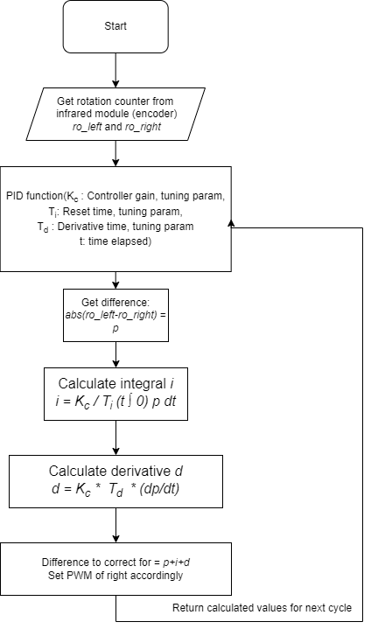
Motor control (PWM+pid)
Notes:
Change this to be as near to source code as possible

Slide 6
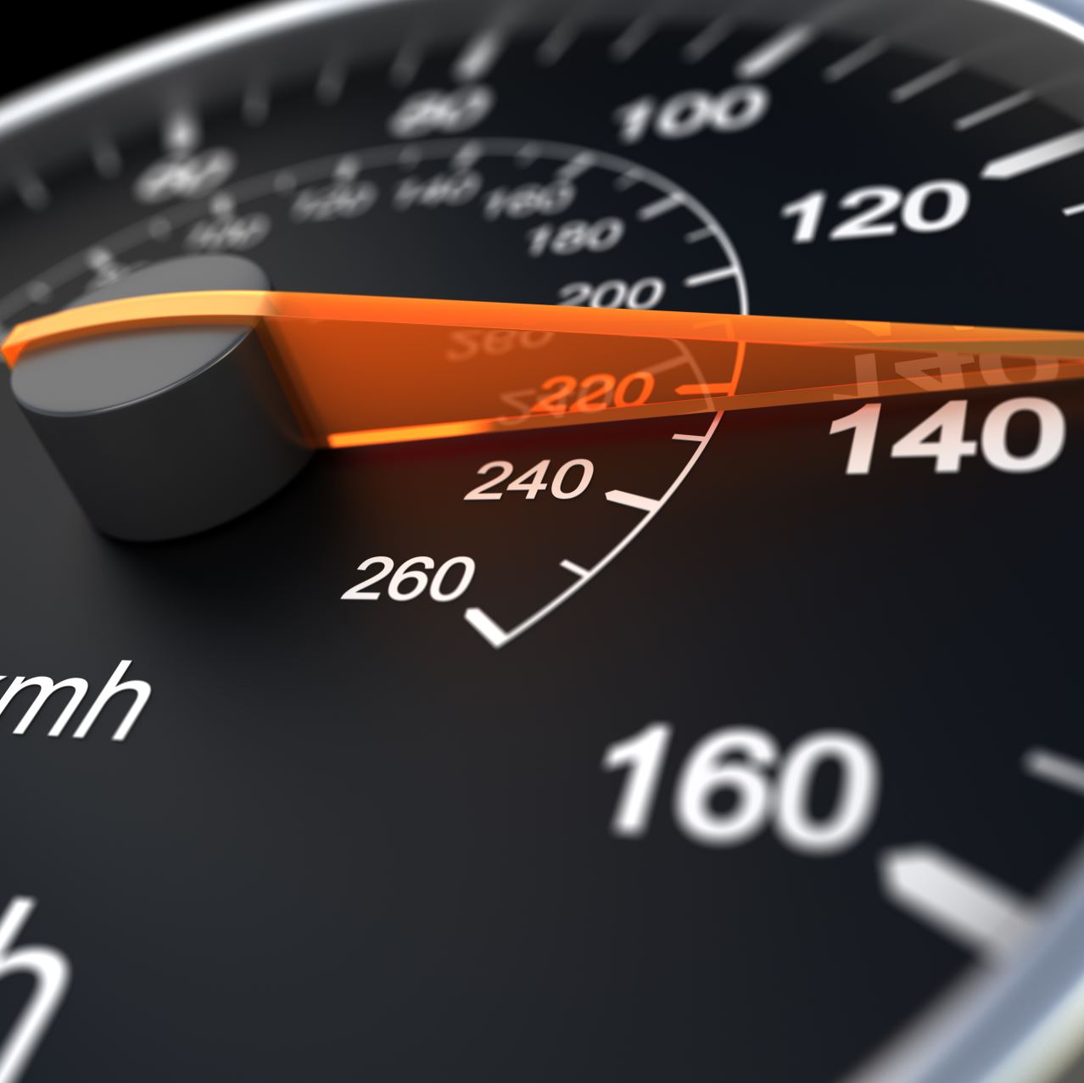
What is PID
A Feedback control system
P: Proportion to existing error (i.e., RPM difference between 2 wheels)
I: Integral, proportional to magnitude of error and the duration of error to create a correction factor
D: Derivative, rate-of-change, works in tangent with I to reduce the correction factor when P is nearing 0
With the above, we can calculate create an algorithm that will gradually set the wheels to move at the same speed

Slide 7
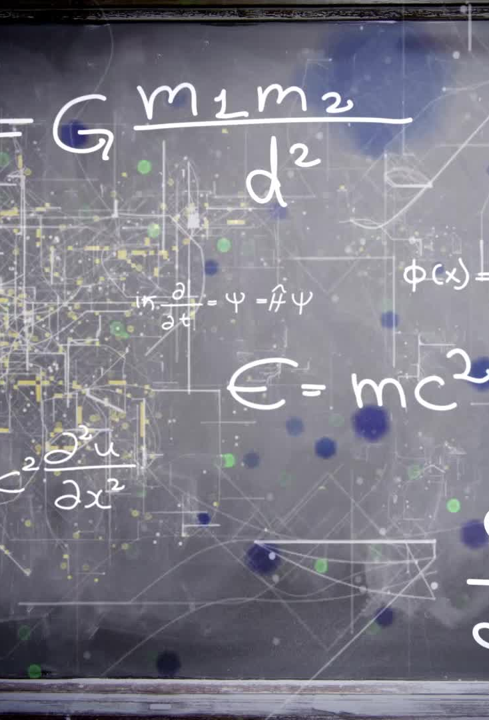
Functions of PID
Functions: calculateRotations(left_rotation: int, right_rotation: int){
return (pwm_a, pwm_b)
}

Slide 8
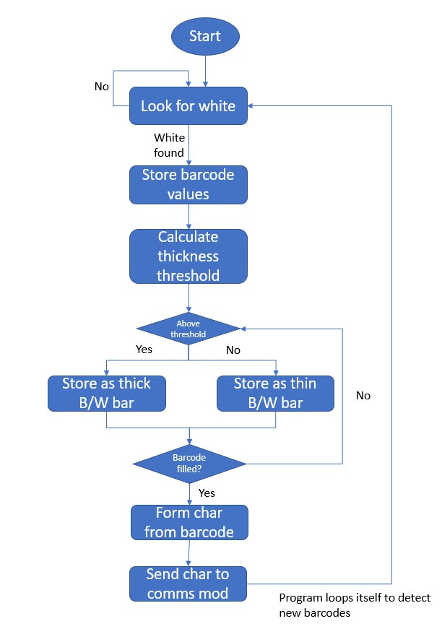
Infrared (encoder+barcode)

Slide 9
What is an Infrared [encoder+barcode]
This device is used to encode and modulate remote controller codes for infrared transmission.
A barcode scanner, or barcode reader, is a device with lights, lenses, and a sensor that decodes and captures the information contained in barcodes.

Slide 10
Functions of [encoder+barcode]
Encoder– Calculate Speed of Car using the infrared sensor & wheel notches (rotary encoder)
Using these metrics, Motor Control (PWD/PWM) can regulate the speeds accurately
Collaboration with Motor sub-module to calibrate the motor and encoder efficiently together
Barcode scanner, or barcode reader, is a device with lights, lenses, and a sensor that decodes and captures the information contained in barcodes.
Factoring in car speed to optimize readability of barcode
Work closely with communication sub module to exfiltrate data from decoding the barcode
Error-correction, reverse back to barcode if failure to read

Slide 11
Ultrasonic+accelerometer (Driver's explanation)
Ultrasonic Module (HR-SC04)
Implement Kalman Filter algorithm to reduce the measurement noise of the ultrasonic sensor. (Subject to change)
Detect emitted ultrasonic sonic reflected from nearby object.
Set the detected range to within 100cm.
Possible use case: send an alert when distance is within a range.
Accelerometer Module (M5stick C)
Detect the vibration, or acceleration of motion of the car
Perform data clean up, remove invalid data.
Possible use case: deploy "air bags" when rapid deceleration detected,.

Slide 12
Ultrasonic+accelerometer (Communication plan)
Ultrasonic Module (HR-SC04)
When distance detected is less than xCM
Accelerometer Module (M5stick C)
When anomaly data detected, e.g., rapid deceleration detected send a flag to MSP through MQTT to stop the wheel (motor).

Slide 13
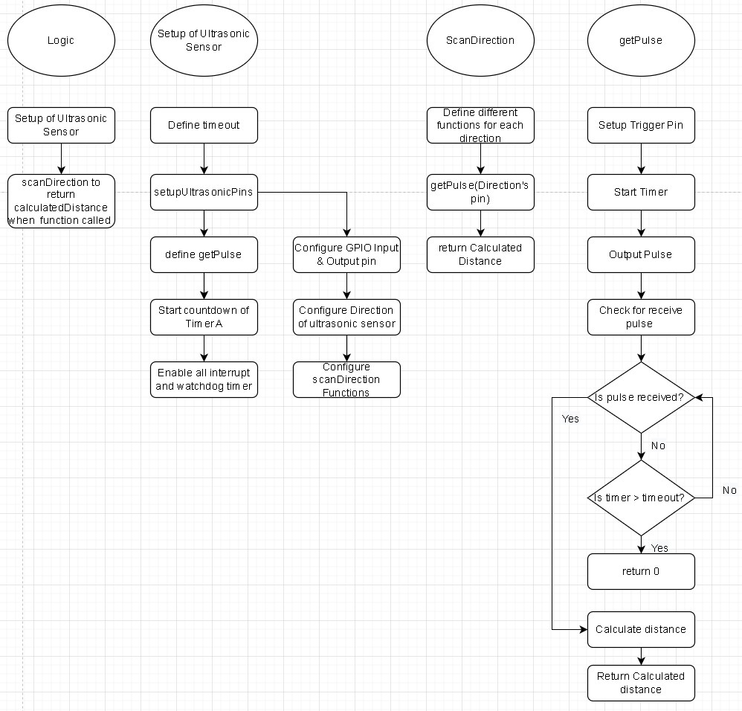
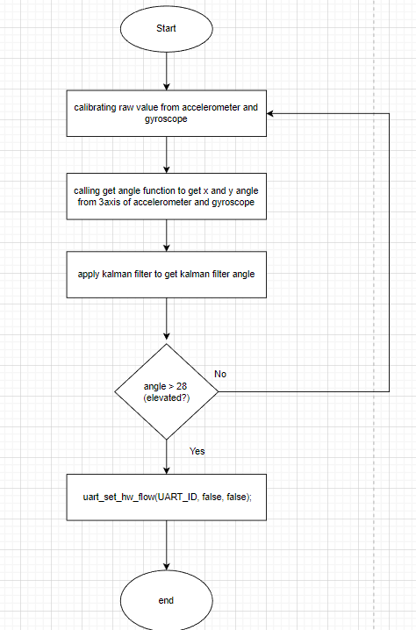
Ultrasonic+accelerometer (Flow Chart)

Slide 14
Communications (FEATURES)
MSP432 M5Stick UART
Pico HC05 UART
Pico I2C
Pico M5Stick UART (Integrated)

Slide 15
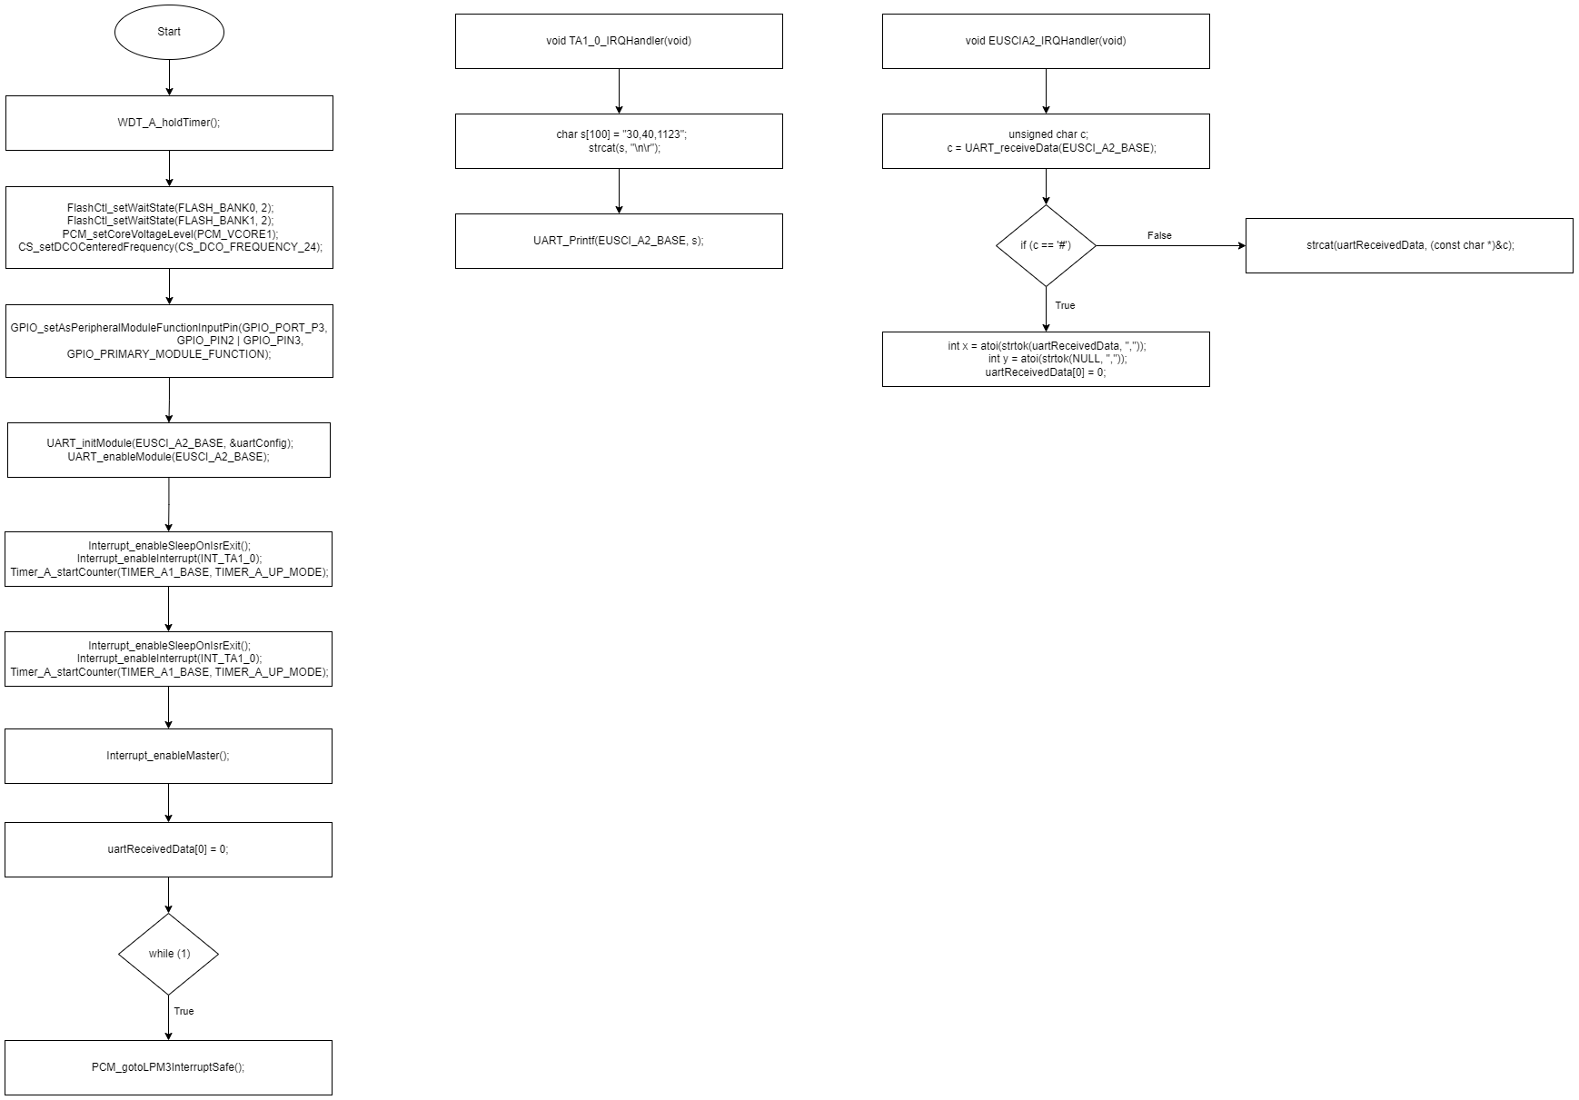
MSP432 M5Stick UART (FLOWCHART)
https://github.com/danielkieuu/CSC2003-B1/tree/main/Communication#msp_m5stick_uart

Slide 16
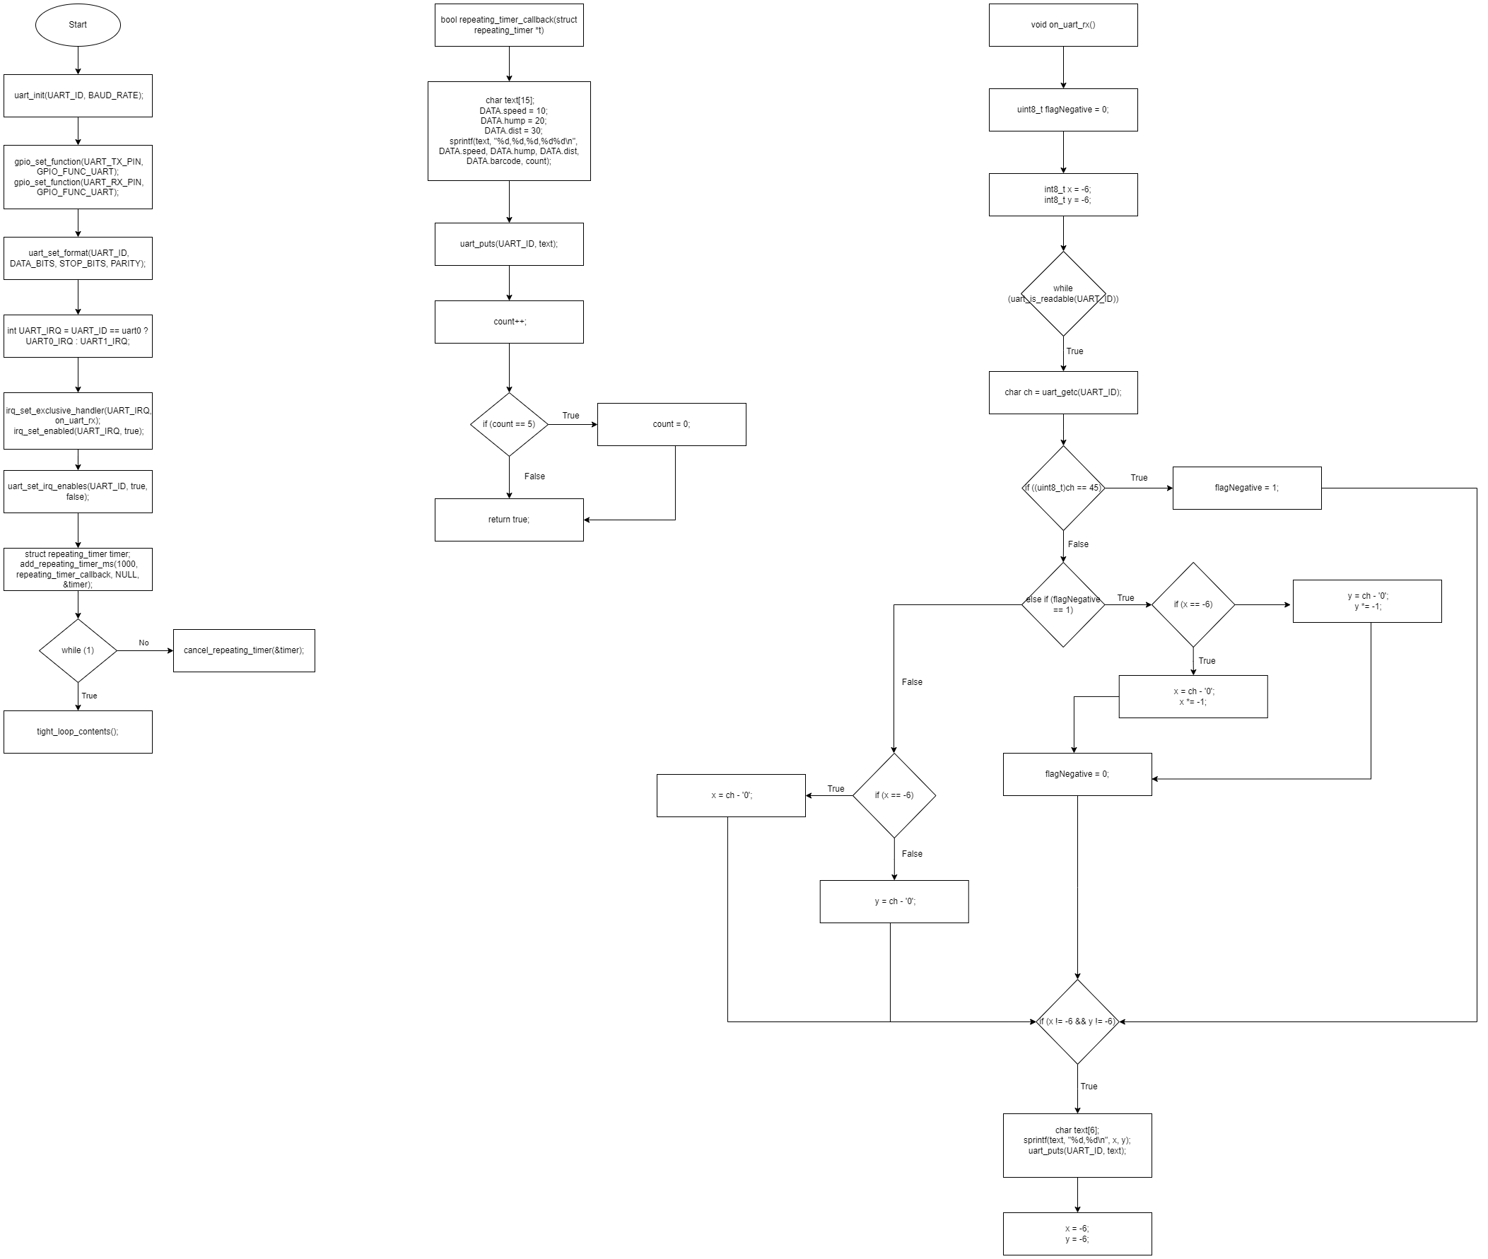
Pico M5Stick UART(FLOWCHART)
https://github.com/danielkieuu/CSC2003-B1/tree/main/Communication#flowchart

Slide 17
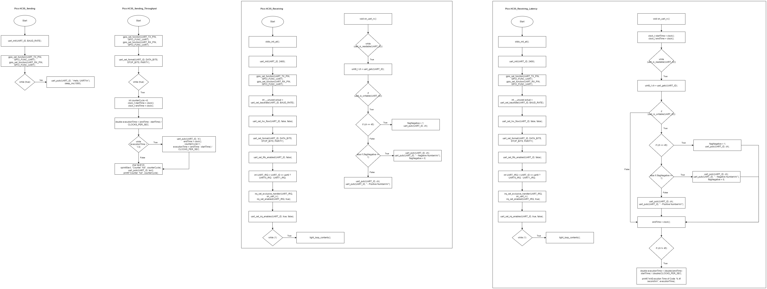
Pico HC05 UART (FLOWCHART)
https://github.com/danielkieuu/CSC2003-B1/tree/main/Communication#flowchart-2

Slide 18
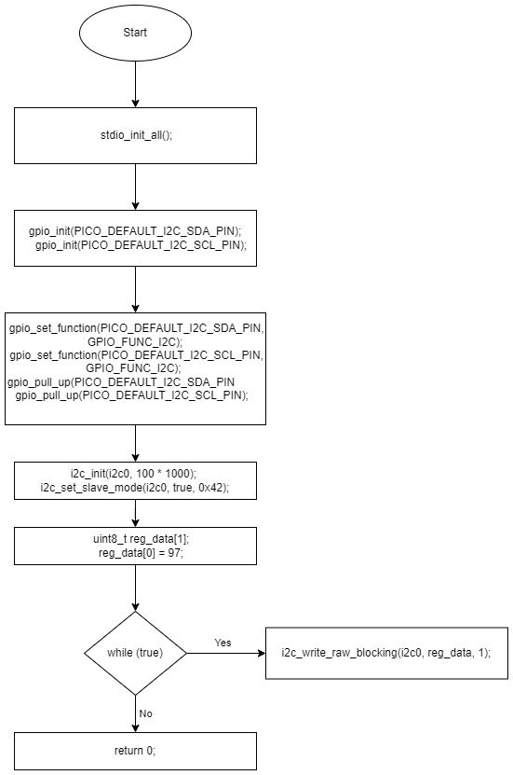
Pico i2c(FLOWCHART)
https://github.com/danielkieuu/CSC2003-B1/blob/main/Communication/readme.md#flowchart-3

Slide 19
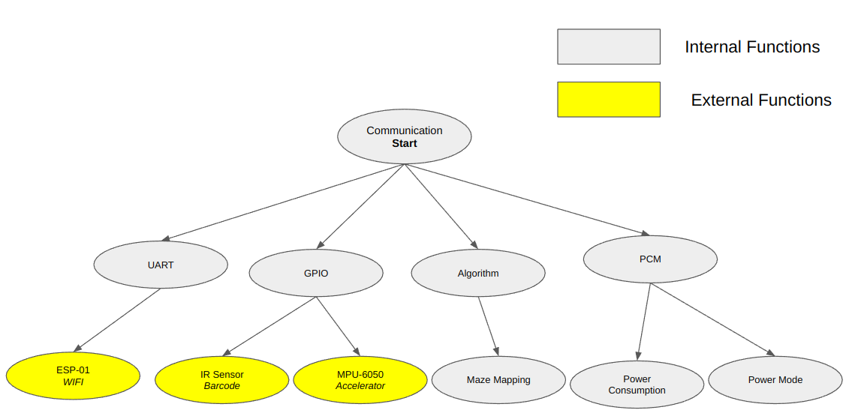
Communications (Call Graph)

Slide 20
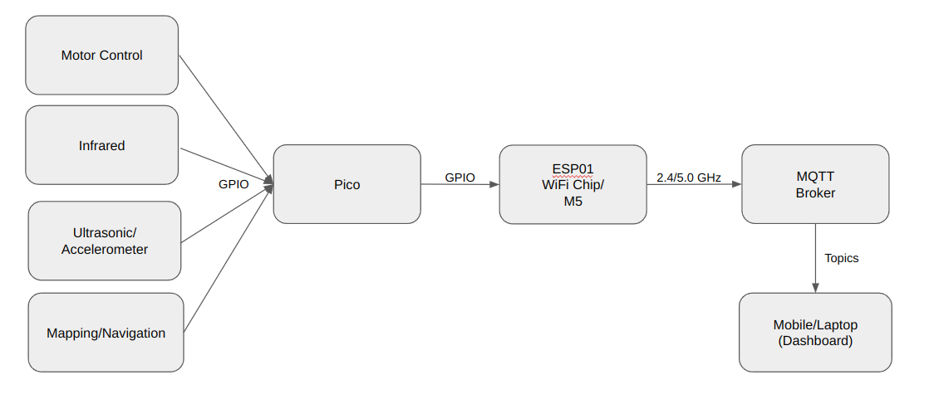
Communications (Data-flow)

Slide 21
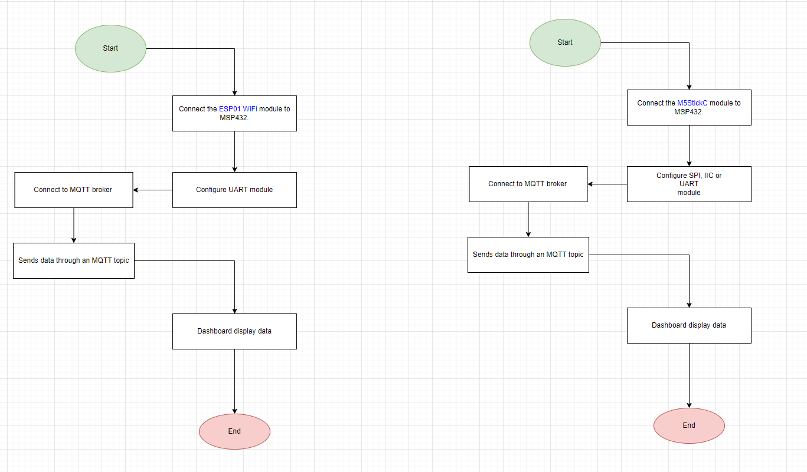
Communications (Flowchart)

Slide 22
Mapping & navigation (Features)
Mapping out the arena into nodes
Checking node neighbors (spin)
Traversing to un-traversed nodes

Slide 23
Mapping & navigation (CALL GRAPH)
MAPPING
PWM + PID
Ultrasonic
Communications
Motor
HR-SC04
ESP01-WIFI

Slide 24
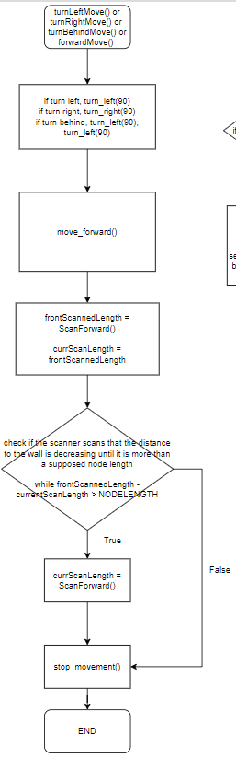
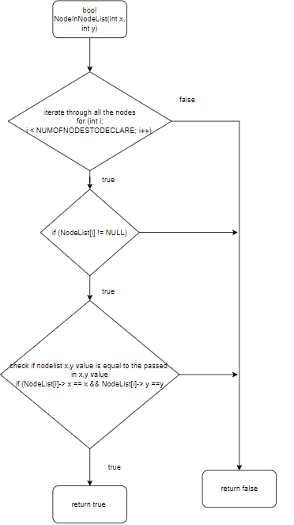
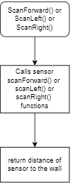
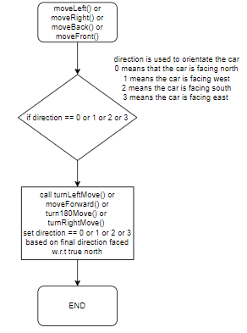
Mapping & navigation (FLOWCHART)

Slide 25
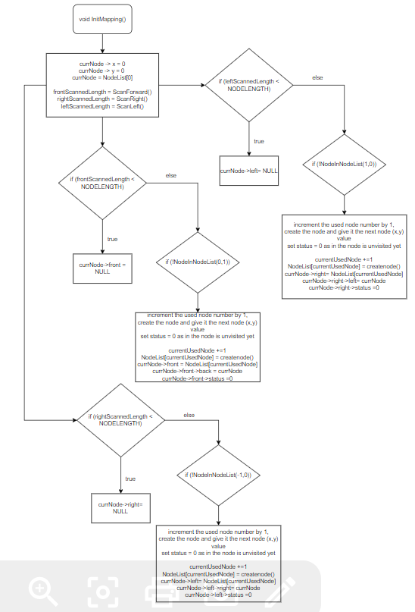
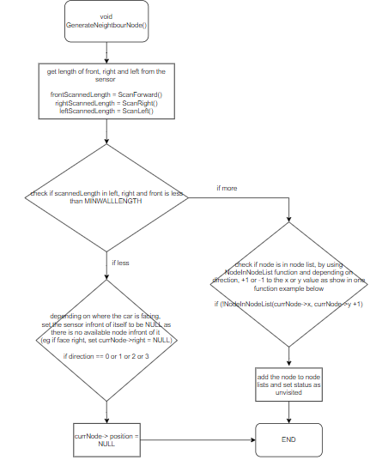
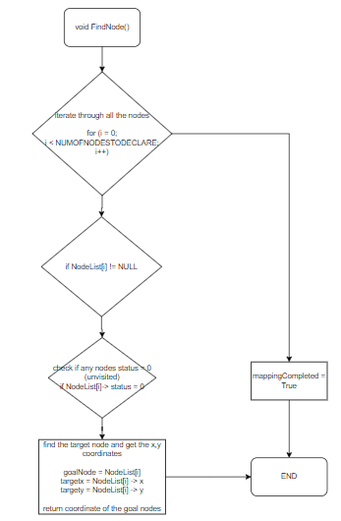
Mapping & navigation (FLOWCHART)

Slide 26
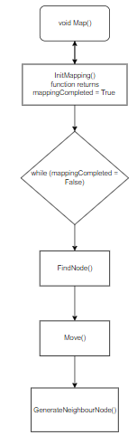
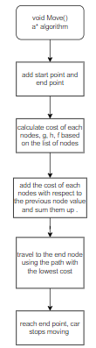
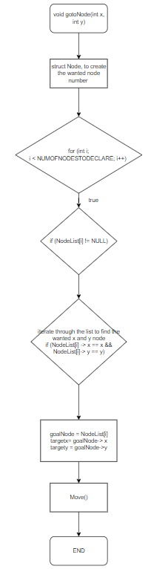
Mapping & navigation (FLOWCHART)

Slide 27







‘Drunken’ Robotic Car
Infrared
Ultrasonic
PWM + PID
Mapping
Communications
Encoder + Barcode
HR-SC04
Motor
ESP01-WIFI

